Slide 1
Capstone Group 43 - Inferno
Solar Car Simulation
Phoenix Solar Racing
Dennie Devito, Logan Kling, Dakota Zaengle

Slide 2
Purpose
We are building software for Phoenix Solar Racing.
They need a way to predict their new solar car’s performance before they race.
The information they receive from our program will allow them to create a racing strategy before they start the course.

Slide 3
Goals
To provide a simple and easy to use interface to allow team members to use the software efficiently.
To make the simulation program estimate the energy usage of the vehicle over a given time period or distance at a given speed.
To estimate the required speed to use a given amount of energy to cover a given distance in a specified amount of time
To include factors like the electrical and mechanical efficiency of the vehicle and the prevailing weather conditions.

Slide 4
Plan
Our TA has asked us to have a functional alpa by week 8 or 9
May not include things like the howto section and other non-essential parts.
Will let us test the functionality with PSR
Development of the GUI and the calculations have made progress, the next step is to combine them
This has let us test them without having everything complete
Optimization can come later

Slide 5
Design
Simplicity
Faster
Easier to program
Easier to use
Usability
Saving input
Get feedback from our clients
Portability
Should be useable on their Windows systems
Clarity of Code
Allow them to make changes years later

Slide 6
Weekly Review, Week 1 - 6 (Dennie Devito)
No class
GUI
Mapping API
WxWebView
Weather API

Slide 7
Phoenix Solar Racing
We have attended some of PSR’s meetings
Showed them the GUI and made some changes based on their suggestions
Their schedule for building the car may dictate how the program is tested.
Delays in printing the body
Testing with race data from the old car will be our best bet

Slide 8
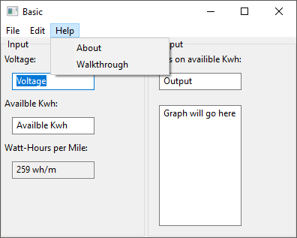
GUI - wxWidgets
Progress
Layout
Save/Load
wxWebView problems

Slide 9
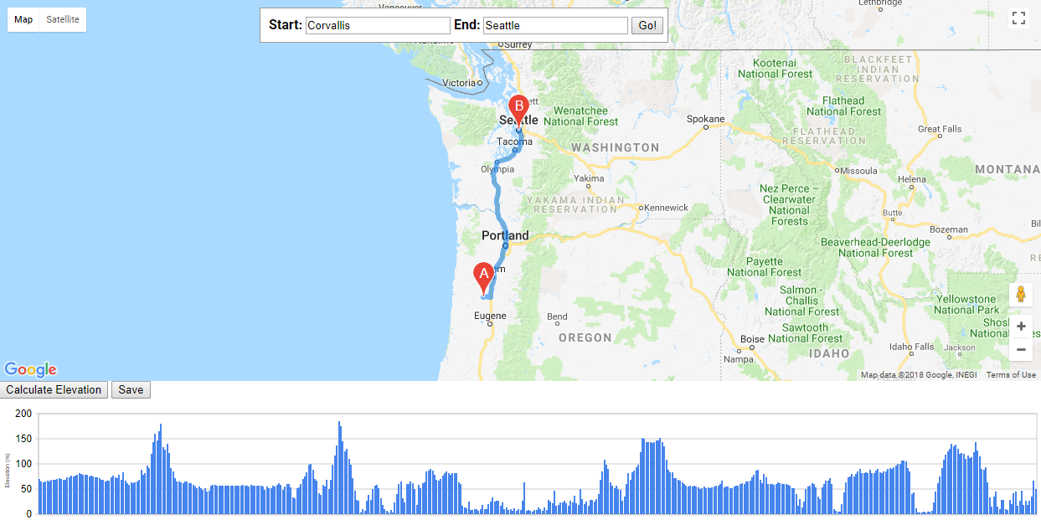
Web Page for Google
Licence requirements for using Google API
Compatibility trouble with wxWebView
Standalone Web Page
Lets us have more of the Google Map interaction
Data can be saved for later

Slide 10
Testing
Talks with PSR
No real tests yet
We have mostly discussed layout
Our own testing so far limited to personal use

Slide 11
Winter Term First Six Weeks - Dakota Zaengle
Week 1 - wxWidgets Setup
Week 2 - UI Design
PSR meeting
Week 3 - Making the UI
Week 4 - Google Licensing in the GUI
Week 5 - wxWebView Workaround
Week 6 - Poster and Progress Report

Slide 12
Conclusion - Dakota Zaengle
Plan and Design
Testing with the Solar Car
Bumps along the road

Slide 13
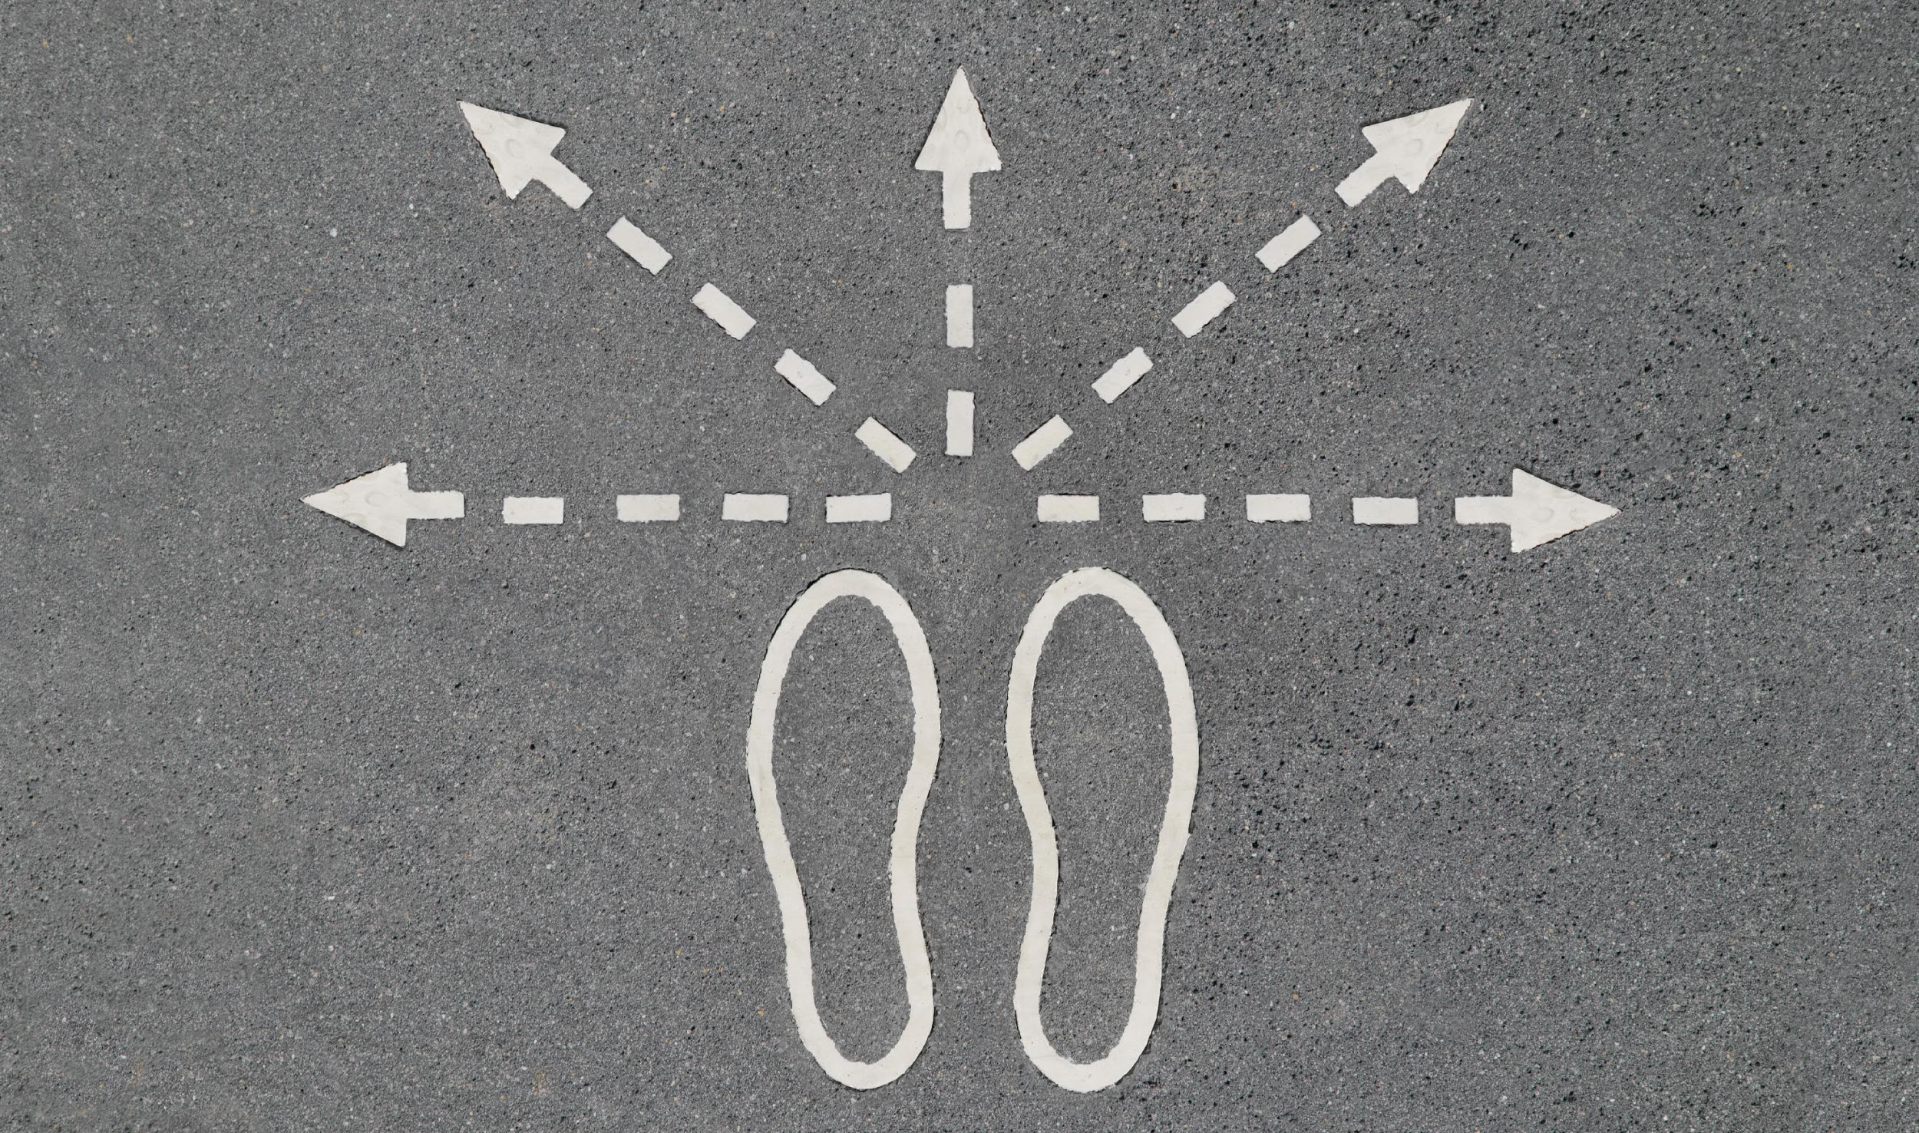
Week One
Winter Break
Did nothing but sleep and socialize
Went to the early class on Tuesday.
No class on Thursday, or any day unless we receive some form of announcement stating otherwise.
No TA meeting.
Chose optimal TA meeting times.

Slide 14

Week Two
Dakota & I met with our TA, Daniel Lin.
Our TA wanted us to bring him a coded GUI by next week.
Dakota focused on this.
I worked on ECE375.

Slide 15
Week Three
We promised our TA a program that can calculate the distance between two points on the same continent.
We wanted this application to work offline.
Would have to store a map of the world to a local file.
I thought I could download the data for such a map, but I couldn’t find anything.
I tried to use Google maps API but I would have needed to create an entire browser framework to use it.
I did create a function that would calculate distance traveled from speeds 15-65mph at an incline given by the user, and an optional initial charge.

Slide 16
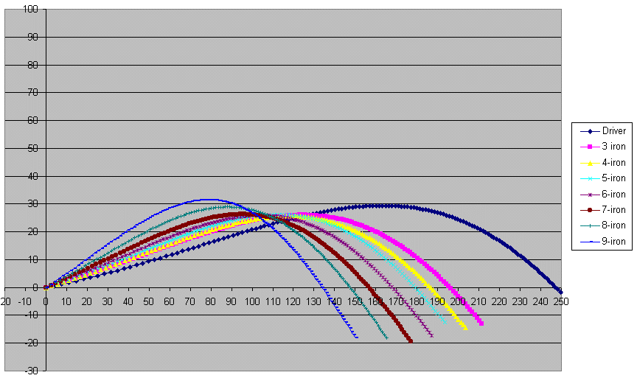
Week Four
Promised our TA a program that could produce a graph from what I created last week.
I found plenty of resources for creating a dynamic graph, but I didn't need a dynamic graph and implementing a dynamic graph would be far more difficult than implementing a static graph.
Eventually, I was forced to settle for implementing a dynamic graph.
I tried to do this, but I ran out of time.

Slide 17

Week Five
Again, we met with Daniel on Tuesday.
As I had been unable to finish my portion of this program by Tuesday of this week, I again promised Daniel to implement a program that could produce a graph from an incline given by the user, and an optional initial charge.
I discovered that I couldn't implement a dynamic graph with WxWidgets, despite the fact that WxWidgets claims it can be used to draw graphs!
I worked to solve this by using WxMathPlot, but I couldn't even manage to make that work.

Slide 18
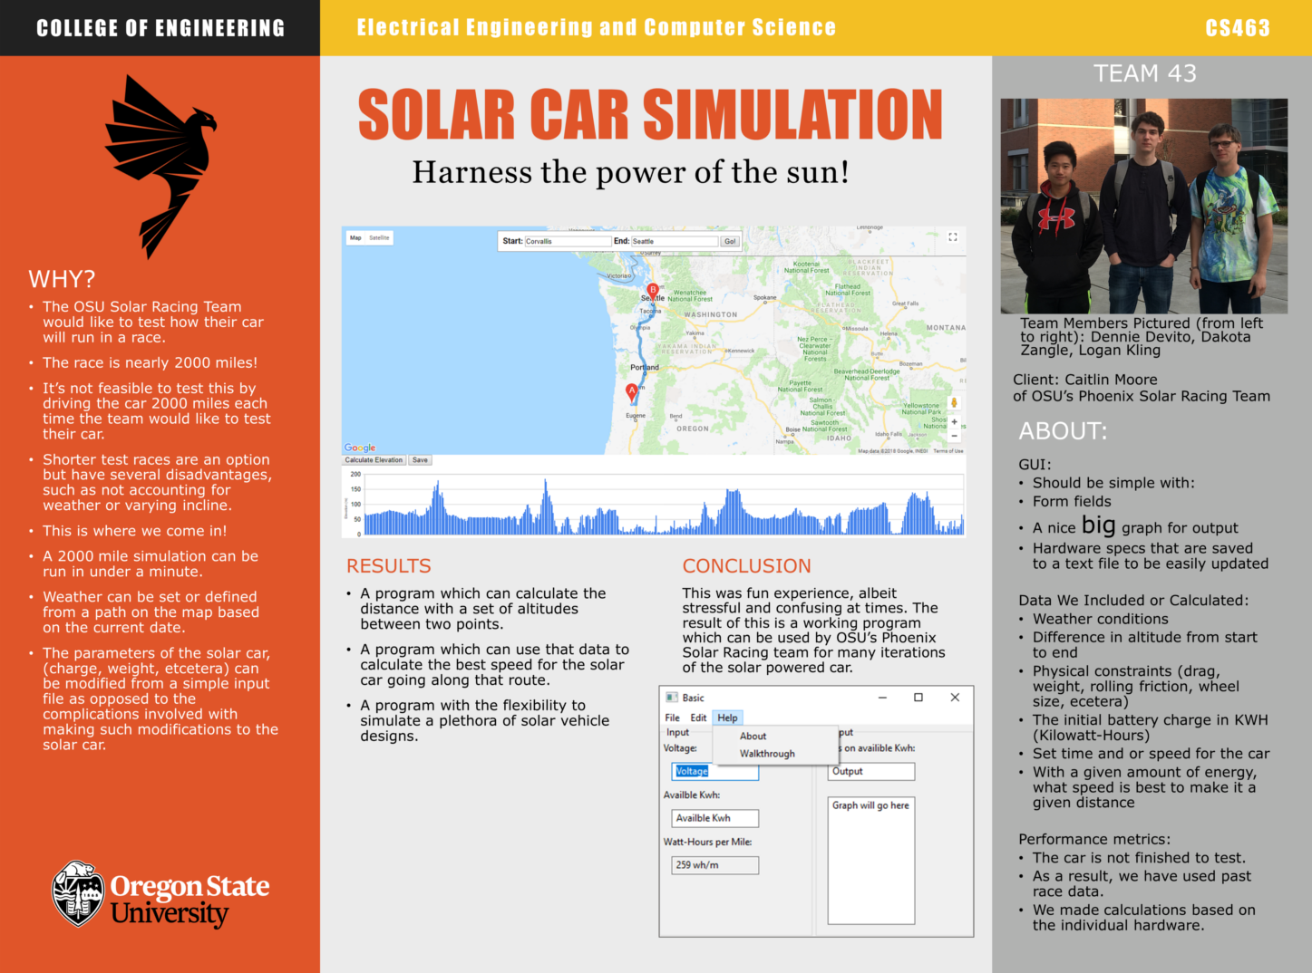
Week Six
Dakota and I met with Daniel on Tuesday.
I worked exclusively on the poster to complete it by the next day.
I finished at least a rough draft of our poster and sent it to our TA on Wednesday, but I will certainly need to make some revisions to it.
The white border is an issue and I'll need to improve the results and conclusion sections as we finish our program.
I may replace the pictures with higher resolution versions.

Slide 19

Conclusion
Now, we're here, working on this progress report.
The entire quarter up to this far has been surprisingly busy.
ECE375 has taken a minimum of thirty hours out of my week each week.
My progress this term has been minimal.
There's no excuse for my lack of working code, but at least it's caused by my stupidity and not by laziness.

Slide 20
Background Image Sources:
https://www.acceluspartners.com/wp-content/uploads/2014/09/which-way.jpg
http://www.abstract-living.com/wp-content/uploads/2015/05/meeting-strangers.jpg
http://www.probablegolfinstruction.com/clubrange.gif
https://cdn.technologyreview.com/i/images/readinglist1.png?sw=2760
http://www.jeffmwangicompany.co.ke/wp-content/uploads/2016/09/Requirements.jpg
http://images.clipartpanda.com/conclusion-clipart-tcftc_img15.jpg

